Slide 1
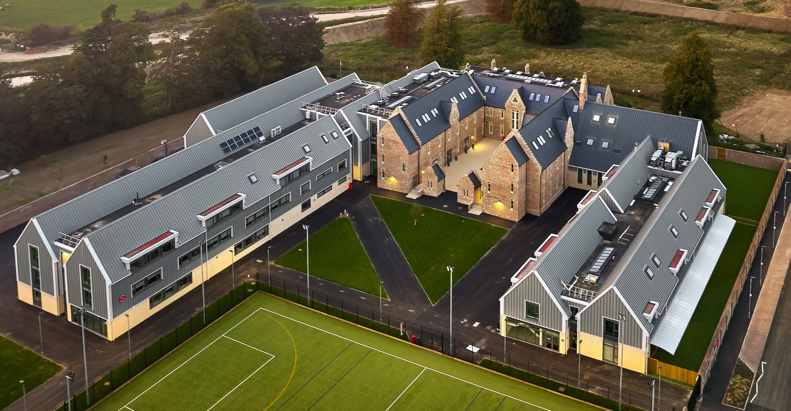

Year 6-7 Transition
Mr James Garner
Executive Principal
Mr Ben Phillips
Head of Secondary
Notes:
LHN

Slide 2
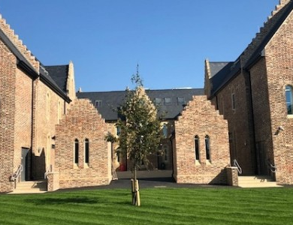

Back to School Section on Website
Parent Pack
Home School Agreement
Pupil Code of Conduct
Rhythm of the Year
Uniform Policy
Notes:
LHN

Slide 3
The CFS House System
Enrichment, fun, competition and celebration!
House Ambassadors
House Events
House Points
Community/family feel; each tutor group will be from one house
Sports Day - pivotal event in the year.
AQUILA | NOCTUA | PEGASUS | PHOENIX
Notes:
LHN

Slide 4
Who’s Who?
Executive Principal – Mr James Garner
Head of Secondary - Mr Ben Phillips
Deputy Head of Secondary - Mr Lee Hardwick
Assistant Head: Secondary SENDCo – Mr Phil Fowler
Year 7 Teaching Team – Mrs Higgins (Lead)/ Mrs Brett, Mrs Shaw
Notes:
LHN, Slide needs completing

Slide 5
Who’s Who?
Head of Year 7: Miss Oxley
Assistant Head of Year 7: Miss Ireland
Aquila Tutor: Mrs Higgins/Mrs Brett
Noctua Tutor: Mrs Vann
Pegasus Tutor: Miss Beckett
Phoenix Tutor: Miss Kite
Who should I contact if…?
Notes:
LHN

Slide 6
Secondary School Day
Start of the day at 8.15 with line up
  Pupils welcome on site from 7.45 (canteen or main playground)
30 minute morning tutor time: register, tutor notices, uniform and equipment checks, group support, Year group assemblies, mentoring
6 x 55 minute lessons each day
30 minute morning break
40 minute lunch break
Compulsory school day ends at 15.30 for all
Voluntary extended day runs from 15.30 to 16.30: clubs, supervised study, interventions, revision clinics, fixtures, production rehearsals etc
Notes:
LHN

Slide 7
Notes:
LHN

Slide 8
High Expectations,
High Support,
High Celebration
‘Be in the right place, at the right time, doing the right thing’
Notes:
CED

Slide 9


Slide 10
A Few Other Points
16th September 5pm-6:30pm ‘Meet the Tutor’
Canteen and the cashless system – Parent Pay
Uniform and equipment – Game Set and Match
Management Information System (Arbor)
Bring your own device
Friends of CFS and Parent Ambassadors
Notes:
LHN

Slide 11
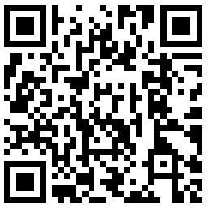
SUMMER SCHOOL 2026
Tuesday 18th – Thursday 20th August
Scan the QR code and fill in the form to sign up by 5pm on
Thursday 2nd July

Slide 12

First day of term (Settling in Day)
9:00am
2nd September
Notes:
LHN

Slide 13
Year 6-7 Transition
Mr James Garner
Executive Principal
Mr Ben Phillips
Head of Secondary
Notes:
LHN

